Slide 1
TV DISTRIBUTION:
24 Hours of LeMans
₁₅₋₁₆ th
JUNE 2 0 2 4
1 6: 0 0 – 16 : 0 0 L O C A L T I M E

Slide 2
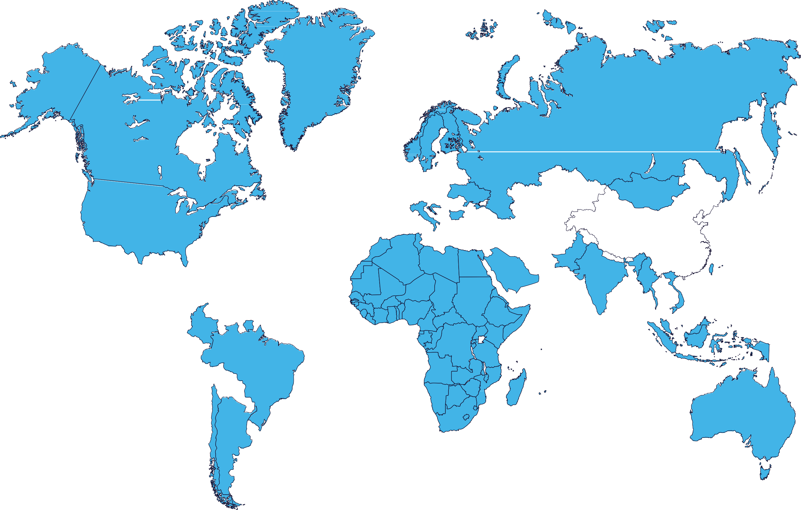
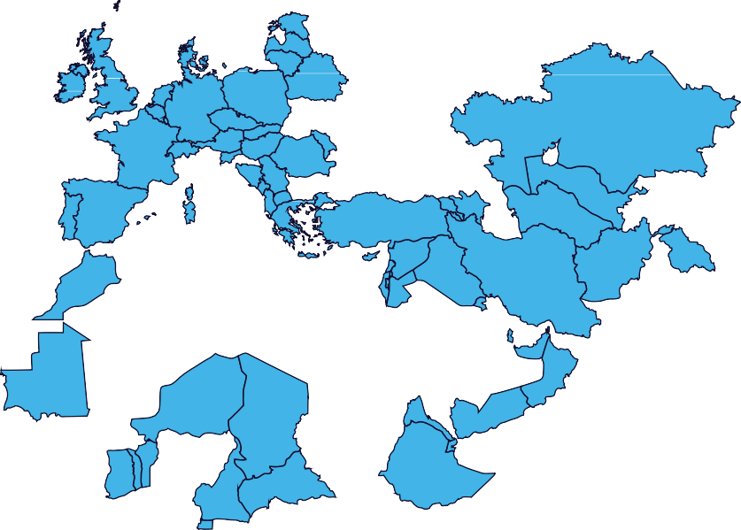
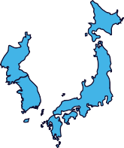
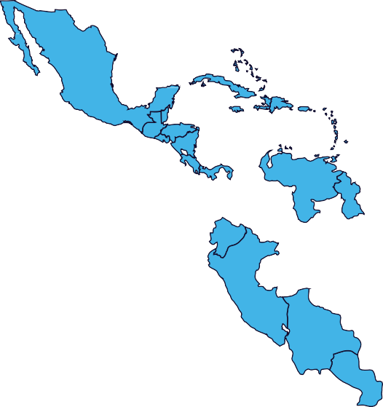
FIA WEC 2024
Broadcast Partners
Pan-Europe;
Pan-Asia-Pacifict
France, MENA,
Africa, Pan-Asia-
Pacific, Americas

Slide 3
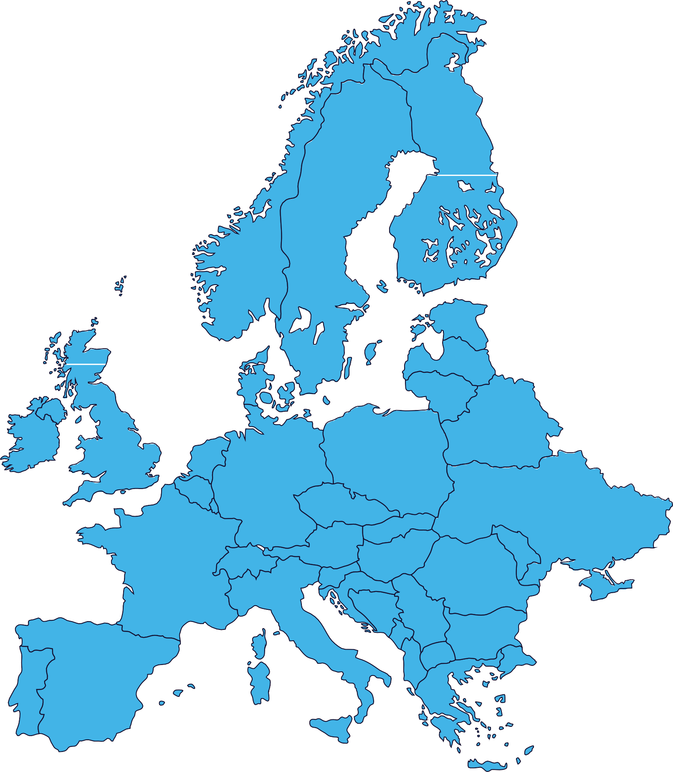
FIA WEC 2024
Broadcast Partners
Pan-Europe;
Pan-Asia-Pacifict
France, MENA,
Africa, Pan-Asia-
Pacific, Americas

Slide 4
European Broadcasters - LIVE | Rerun | Delayed
Territories | Broadcaster | Info | Local time unless stated
Pan-Europe (excluding France, Germany, Netherlands and UK) |  | Pay TV | Live Live Live Live Live Live Live | FP 1 on 12/06 13:15-17:15 on Eurosport 2 Qualification Race on 12/06 18:45-20:15 on Eurosport 1 FP2 on 12/06 21:45-00:15 on Eurosport 1 FP3 on 13/06 14:45-18:15 on Eurosport 2 HyperPole on 13/06 19:45-21:15 on Eurosport 1 FP4 on 13/06 21:45-23:15 on Eurosport 1 Full Race on 15-16/06 15:00-17:00 on Eurosport 1
Pan-Europe (excluding discovery+ markets) |  | Pay Digital | Live Live Live Live Live Live Live | FP 1 on 12/06 13:15-17:15 on Player Qualification Race on 12/06 18:45-20:15 on Player FP2 on 12/06 21:45-00:15 on Player FP3 on 13/06 14:45-18:15 on Player HyperPole on 13/06 19:45-21:15 on Player FP4 on 13/06 21:45-23:15 on Player Full Race on 15-16/06 15:00-17:00 on Playe
United Kingdom, Germany, Denmark, Sweden, Norway, Finland, Netherlands, Italy and Indian Subcontinent |  | Pay Digital | Live Live Live Live Live Live Live | FP 1 on 12/06 13:15-17:15 on Discovery+ Qualification Race on 12/06 18:45-20:15 on Discovery+ FP2 on 12/06 21:45-00:15 on Discovery+ FP3 on 13/06 14:45-18:15 on Discovery+ HyperPole on 13/06 19:45-21:15 on Discovery+ FP4 on 13/06 21:45-23:15 on Discovery+ Full Race on 15-16/06 15:00-17:00 on Discovery+

Slide 5
European Broadcasters - LIVE | Rerun | Delayed
Territories | Broadcaster | Info | Local time unless stated
Belgium |  | Free-to-Air | Live Live | Qualification on 13/06 on TIPIK Full Race on 15-16/06 15:50-16:20 on on TIPIK
Belgium |  | Free Digital | Live Live | Qualification on 13/06 on AUVIO Full Race on 15-16/06 15:50-16:20 on on AUVIO
Denmark |  | Free-to-Air | Live | Race on 15/06 15:55-17:51, 20:57-22:19, 22:36-23:48 on TV2 Race on 16/06 00:00-06:50, 07:10-09:52, 10:10-11:49, 12:06-13:19, 13:36-16:05 and 16:15-16 53 on TV2 PLAY
Denmark |  | Pay Digital | Live | Race on 15/06 15:55-17:51, 20:57-22:19, 22:36-23:48 on TV2 Race on 16/06 00:00-06:50, 07:10-09:52, 10:10-11:49, 12:06-13:19, 13:36-16:05 and 16:15-16 53 on TV2 PLAY
Denmark |  | Pay TV | Live Live | Race Part 1 on 15/06 16:00-19:00 on 6’eren Race Part 2 on 15-16/06 22:00-16:00 on 6’eren
France |  | Free-to-Air | Live | Pre-Race on 15/06 12:30-16:00 on L’Equipe Race Part 1 on 15-16/06 16:00-01:30 on L’Equipe Race Part 2 on 16/06 05:00-17:45 on L’Equipe

Slide 6
European Broadcasters - LIVE | Rerun | Delayed
Territories | Broadcaster | Info | Local time unless stated
France |  | Free Digital | Live | Pre-Race on 15/06 12:30-16:00 on lequipe.fr Race Part 1 on 15-16/06 16:00-01:30 lequipe.fr Race Part 2 on 16/06 05:00-17:45 on lequipe.fr
France |  | Pay TV | Live Live Live Live Live Live Live | FP 1 on 12/06 13:15-17:15 on Eurosport 2 Qualification Race on 12/06 18:45-20:15 on Eurosport 1 FP2 on 12/06 21:45-00:15 on Eurosport 1 FP3 on 13/06 14:45-18:15 on Eurosport 2 HyperPole on 13/06 19:45-21:15 on Eurosport 1 FP4 on 13/06 21:45-23:15 on Eurosport 1 Full Race on 15-16/06 15:00-17:00 on Eurosport 1
Germany / DACH |  | Pay TV Free-to-Air Free-to-Air Pay TV Free-to-Air Free-to-Air Free-to-Air | Live Live Live Live Live Live Live | FP 1 on 12/06 13:15-17:15 on Eurosport 2 Qualification Race on 12/06 18:45-20:15 on Eurosport 1 FP2 on 12/06 21:45-00:15 on Eurosport 1 FP3 on 13/06 14:45-18:15 on Eurosport 2 HyperPole on 13/06 19:45-21:15 on Eurosport 1 FP4 on 13/06 21:45-23:15 on Eurosport 1 Full Race on 15-16/06 15:00-17:00 on Eurosport 1
Germany |  | Free-to-Air | Live | Full Race on 15-16/06 14:45-16:45 on RTL Nitro
Germany |  | Pay Digital | Live | Full Race on 15-16/06 14:45-16:45 on RTL+

Slide 7
European Broadcasters - LIVE | Rerun | Delayed
Territories | Broadcaster | Info | Local time unless stated
Italy |  | Free-to-Air | Live | Partial Race on 15/06 16:00-17:00 on Motortrend
Netherlands & Luxembourg |  | Free-to-Air | Live | Full Race on 15-16/06 15:00-16:30 on RTL 7
Netherlands |  | Pay Digital | Live | Full Race on 15-16/06 15:00-16:30 on Videoland
Netherlands |  | Pay TV | Live Live Live Live Live Live Live Live | FP 1 on 12/06 13:15-17:15 on Eurosport 2 Qualification Race on 12/06 18:45-20:15 on Eurosport 1 FP2 on 12/06 21:45-00:15 on Eurosport 1 FP3 on 13/06 14:45-18:15 on Eurosport 2 HyperPole on 13/06 19:45-21:15 on Eurosport 1 FP4 on 13/06 21:45-23:15 on Eurosport 1 Partial Race on 15-16/06 15:00-16:45 and 15-16/06 18:00-17:00 on Eurosport 1 Race on 15/06 16:45-18:00 on Eurosport 2
United Kingdom |  | Free-to-Air | Live | Partial Race on 15-16/06 22:00-05:00 on Quest

Slide 8
European Broadcasters - LIVE | Rerun | Delayed
Territories | Broadcaster | Info | Local time unless stated
UK |  | Pay TV | Live Live Live Live Live Live Live | FP 1 on 12/06 12:15-16:15 on Eurosport 2 Qualification Race on 12/06 17:45-19:15 on Eurosport 1 FP2 on 12/06 20:45-23:15 on Eurosport 1 FP3 on 13/06 13:45-17:15 on Eurosport 2 HyperPole on 13/06 18:45-20:15 on Eurosport 1 FP4 on 13/06 20:45-22:15 on Eurosport 1 Full Race on 15-16/06 14:00-16:00 on Eurosport 1

Slide 9
Americas Broadcasters - LIVE | Rerun | Delayed
Territories | Broadcaster | Info | Local time unless stated
Brazil |  | Pay TV | Live Delayed Delayed | Race Live on 15/06 07:30-10:00 on Band Sports Delayed on 15/06 19:30-20:30 on Band Sports Delayed on 16/06 20:30-22:30 on Band Sports
Brazil |  | Free Digital | Live | Full Race on 15-16/06 11:00-12:00 on Bandplay
Brazil |  | Free Digital | Live | Full Race on 15-16/06 11:00-12:00 on EsporteNaBand
Brazil |  | Free Digital | Live | FP 1 on 12/06 08:15-12:15 on Grande Premio Qualification Race on 12/06 14:45-17:15 on Grande Premio FP2 on 12/06 17:45-21:15 on Grande Premio FP3 on 13/06 011:45-15:15 on Grande Premio FP4 on 13/06 17:45-19:15 on Grande Premio Full Race on 15-16/06 11:00-12:00 on Grande Premio youtube.com/@GrandePremio1 Race on TikTok Brazil
Canada |  | Pay TV | Live | Full Race on 15-16/06 from 09:00-11:00 on Velocity

Slide 10
Americas Broadcasters - LIVE | Rerun | Delayed
Territories | Broadcaster | Info | Local time unless stated
Canada |  | Pay Digital | Live Live | Full Race live on 15-16/06 (English Commentary) Full Race live on 15-16/06 (French Commentary)
Mexico |  | Pay TV | Live Live Live Live Live Live | Qualification Race on 12/06 10:45-14:15 on Fox Sports 3 HyperPole on 13/06 11:45-13:00 on Fox Sports 3 Race Part 1 on 15/06 07:00-13:30 on Fox Sports 3 Race Part 2 on 15/06 16:00-17:55 on Fox Sports 3 Race Part 3 on 15-16/06 23:00-01:00 on Fox Sports 3 Race Part 4 on 16/06 05:00-09:00 on Fox Sports 3
USA |  | Pay TV | Live Live Live Live Live Live | FP 1 on 12/06 07:15-11:15 on Motortrend Qualification Race on 12/06 12:45-15:15 on Motortrend FP2 on 12/06 15:45-19:15 on Motortrend FP3 on 13/06 08:45-13:15 on Motortrend FP4 on 13/06 15:45-17:15 on Motortrend Full Race on 15-16/06 09:00-11:00 on Motortrend
USA |  | Pay Digital | Live Live Live Live Live Live | FP 1 on 12/06 07:15-11:15 on Max Qualification Race on 12/06 12:45-15:15 on Max FP2 on 12/06 15:45-19:15 on Max FP3 on 13/06 08:45-13:15 on Max FP4 on 13/06 15:45-17:15 on Max Full Race on 15-16/06 09:00-11:00 on Max
Central & South America Caribbean (excl. Mexico & Brazil) |  | Pay TV | Live Live Live | Qualification Race on 12/06 14:45-17:15 on Grande Premio HyperPole on 13/06 14:45-16:15 on Player Full Race on 15-16/06 11:00-12:00 on Grande Premio

Slide 11
Asia-Pacific Broadcasters - LIVE | Rerun | Delayed
Territories | Broadcaster | Info | Local time unless stated
Australia |  | Pay Digital | Live Live Live Live Live Live Live Live Rerun | FP 1 on 12/06 21:45-01:15 on Stan Sport Qualification Race on 13/06 02:45-04:15 on Stan Sport FP2 on 13/06 05:45-08:15 on Stan Sport FP3 on 13/06 22:45-02:15 on Stan Sport HyperPole on 13/06 03:45-05:15 on Stan Sport FP4 on 14/06 05:45-08:15 on Stan Sport Warm-Up on 15/06 19:45-20:30 on Stan Sport Full Race on 15-17/06 from 23:00-01:00 on Stan Sport Reruns as VOD
Australia |  | Free Digital | Live | Partial Race on 16/06 00:00-02:00 on 9GO!
China |  | Free Digital | Live | Full Race on 15-16/06 21:30-22:30 on Douyin
China | Porsche China | Free Digital | Live | Full Race on 15-16/06 21:30-22:30 on Douyin, Weibo and Wechat
India |  | Pay TV
Douyin

Slide 12
Asia-Pacific Broadcasters - LIVE | Rerun | Delayed
Territories | Broadcaster | Info | Local time unless stated
Indonesia |  | Free Digital
Japan |  | Pay TV | Live Rerun Rerun Rerun Rerun | Full Race on 15-16/06 22:20-24:00 on J Sports 1 Rerun Race Part 1 on 17/06 & 01/07 13:50-21:00 on J Sports 3 Rerun Race Part 3 on 18/06 & 02/07 14:30-21:30 on J Sports 3 Rerun Race Part 3 on 19/06 & 03/07 14:30-20:00 on J Sports 3 Rerun Race Part 4 on 20/06 & 04/07 14:30-20:30 on J Sports 3
Japan |  | Pay Digital | Live | FP 1 on 12/06 20:45-22:00 Qualification Race on 13/06 01:45-04:00 FP2 on 13/06 04:45-08:00 FP3 on 13-14/06 21:45-02:00 FP4 on 14/06 04:45-07:00
Pan-APAC |  | Pay TV
Kuy Entertainment

Slide 13
Pan-African, MENA and Other Broadcasters - LIVE | Rerun | Delayed
Territories | Broadcaster | Info | Local time unless stated
Sub-Saharan Africa |  | Pay TV | Live Rerun | Full Race on 15-16/06 15:55-16:00 on MSP / MSPA Full reruns on 19/06 20:00-01:00, 20/06 06:00-01:00, 14:30-15:30, 20:30-21:30 and 21/06 06:00-07:00 on MSP / MSPA
MENA |  | Pay Digital | Live HL | Full Race live on 15-16/06 HLs available online

Slide 14
European Broadcasters – HL | News
Territories | Broadcaster | Info | Local time unless stated
Austria |  | Free-to-Air | HL | HL on 19/06 22:00-23:00 on ORF Sport+
Balkans (Bosnia and Herzegovina, Croatia, Kosovo, North Macedonia, Montenegro, Serbia and Slovenia) |  | Pay TV | HL
Czech Republic |  | Pay TV | HL | HL on 19/06 tbc on Sporty TV, 3 additional HL tba
Czech Republic & Slovakia |  | Pay TV | HL | HL on 19/06 20:00, 20/06 16:00, 28/06 11:20 on NovaSport 5 HL on 19/06 23:30, 20/06 12:15, 22/06 11:15, 23/06 17:00, 24/06 10:45, 27/06 17:25 on NovaSport 6
Czech Republic & Slovakia |  |  | HL

Slide 15
European Broadcasters – HL | News
Territories | Broadcaster | Info | Local time unless stated
Finland |  | Pay TV Pay Digital | HL
France |  | Pay TV | HL
Germany/DACH |  | Free-to-Air Pay TV | HL HL | HL on 19/06 00:00-01:00, 23/06 16:15-17:15 on Sport1 HL on 20/06 00:15-01:00, , 23/06 05:50-06:45 and 25/06 05:50-06:45 on Sport1+
Germany/DACH |  |  | HL
Germany |  | Pay Digital | HL | HL on RTL+ as VOD
Italy |  | Pay TV | HL News | HL on 20/06 as VOD News

Slide 16
European Broadcasters – HL | News
Territories | Broadcaster | Info | Local time unless stated
Italy |  | Free Digital | HL News | HL tba News
Netherlands & Luxembourg |  | Free-to-Air | HL | HL on 23/06 15:00-16:00 and 29/06 15:00-16:00 on RTL 7
Poland |  | Pay TV | HL | HL on 20/06 20:10-21:55 on Motowizja, 8 additional HL tba
Poland |  | Pay TV | HL | HL on 19/06 21:00-22:00 on Polsat Sport 2 HL on 20/06 11:00-12:00 on Polsat Sport 3 HL on 21/06 11:00-12:00 on Polsat Sport 3
Romania |  | Pay Digital | HL
Switzerland |  | Free-to-Air | News | News

Slide 17
European Broadcasters – HL | News
Territories | Broadcaster | Info | Local time unless stated
UK |  | Pay Digital | HL
Pan-Europe |  | Pay Digital | HL
France, Spain, Romania, other Pan-European |  | Pay Digital | HL
United Kingdom, Germany, Denmark, Sweden, Norway, Finland, Netherlands, Italy and Indian Subcontinent |  | Pay Digital | HL
Pan-Europe |  | Free-to-Air | News

Slide 18
Americas Broadcasters – HL | News
Territories | Broadcaster | Info | Local time unless stated
Argentinia |  | Pay TV | HL
Brazil |  | Pay TV | HL
Mexico |  | Pay TV | HL
USA |  | Pay Digital | HL
Central & South America Caribbean (excl. Mexico & Brazil) |  | Pay TV | HL

Slide 19
Asia-Pacific Broadcasters – HL | News
Territories | Broadcaster | Info | Local time unless stated
Australia |  | Pay TV | HL | HL on 18/06 10:00-11:00 on Stan Sport and VOD
Australia |  | Free Digital | HL | HL on 22/06 13:30-14:30 on 9GO!, 1 additional HL tba
India |  | Pay TV | HL
Japan |  | Pay TV | HL | HL on 29/06 22:00-23:00 on J Sports 3, 25 additional HL tba
New Zealand |  | Free-to-Air | HL
Taiwan |  | Pay TV | HL | HL on 29/06 20:30-21:22 on ELTA Sports 1 HL Road to Le Mans on 15/06 07:55-08:30 on ELTA Sports 1

Slide 20
Asia-Pacific Broadcasters – HL | News
Territories | Broadcaster | Info | Local time unless stated
Pan-APAC |  | Pay TV | HL
Pan-Asian Territories |  | Pay Digital | HL

Slide 21
Pan-African, MENA and Other Broadcasters – HL | News
Territories | Broadcaster | Info | Local time unless stated
Sub-Saharan Africa |  | Pay TV | HL | HL tba
Europe (France, Belgium, Switzerland, Monaco), MENA, Pan-Africa, Pan-Asia-Pacific, Central- & South America, USA |  | Free-to-Air | HL

Slide 22
Radio Broadcasters & Other Media
Territories | Broadcaster | Info | Local time unless stated
Worldwide |  | Free | Live | Full Race Live Commentary
Worldwide |  | Pay Digital | Live HL | Full Race live on 15-16/06 HLs available online

Slide 23
Radio Broadcasters & Other Media
Broadcaster | Territories | Local time unless stated
 | Worldwide | Live | Full Race Live Commentary
 | Worldwide | Clips | Coverage in Mobil 1: The Grid distributed internationally

