Slide 1
TV DISTRIBUTION:
6 Hours of São Paulo
₁₄ th
JULY 2 0 2 4
11: 3 0 – 17 : 3 0 L O C A L T I M E

Slide 2
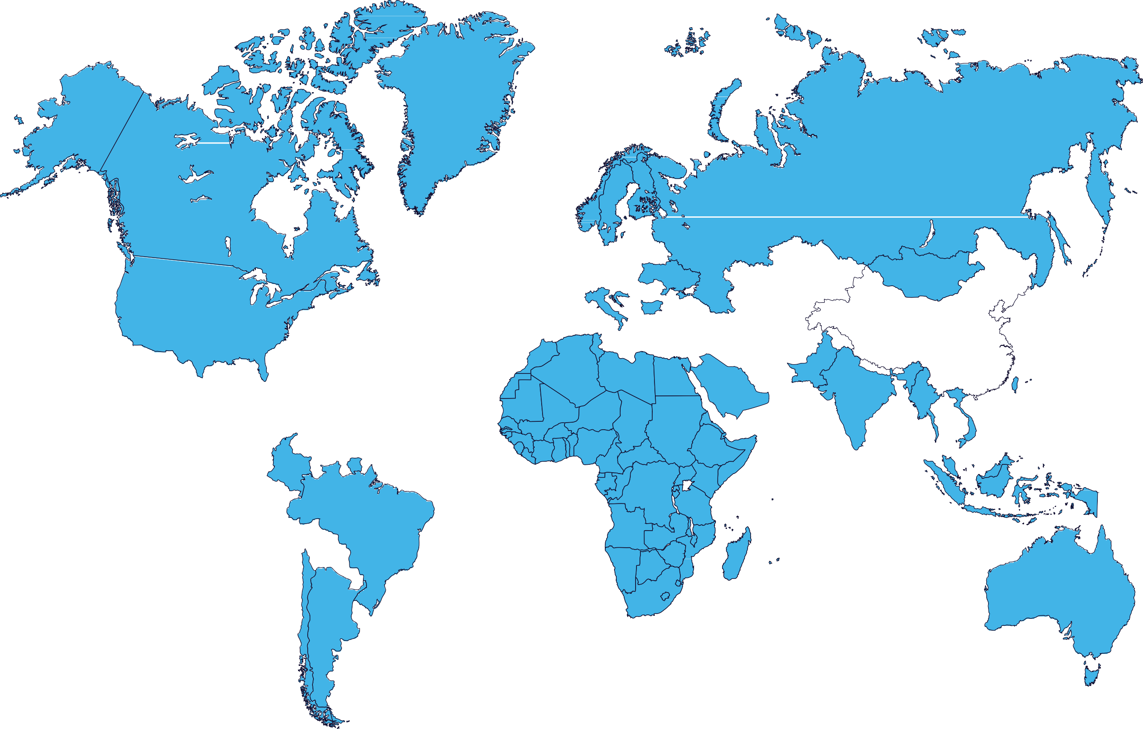
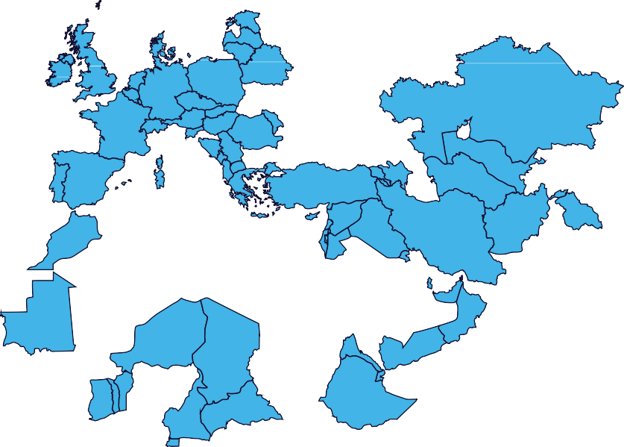
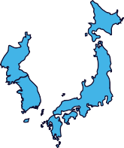
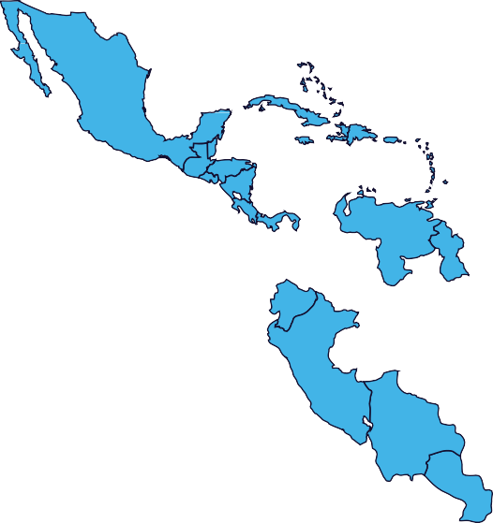
FIA WEC 2024
Broadcast Partners
Pan-Europe;
Pan-Asia-Pacifict
France, MENA,
Africa, Pan-Asia-
Pacific, Americas

Slide 3
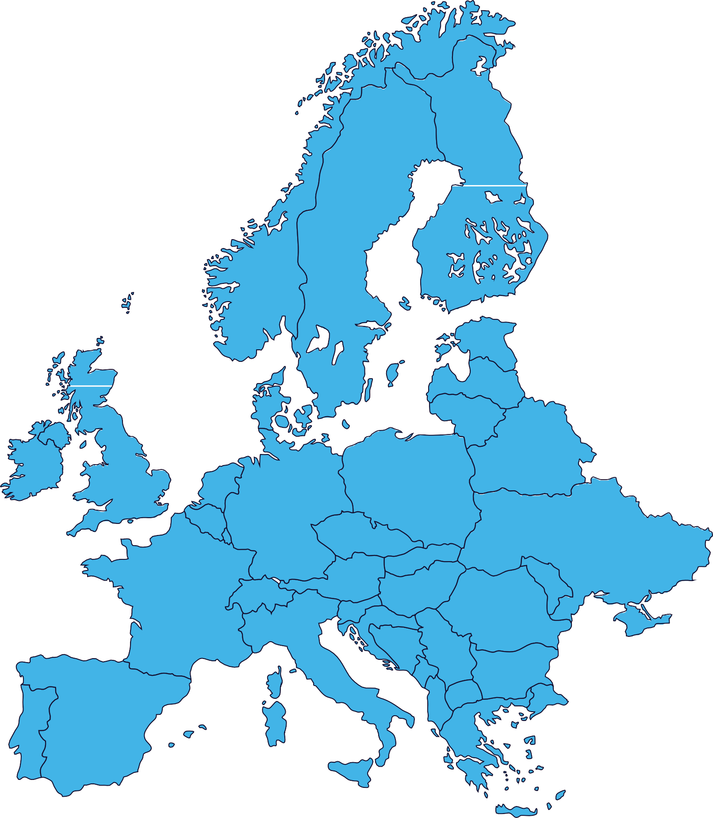
FIA WEC 2024
Broadcast Partners
Pan-Europe;
Pan-Asia-Pacifict
Eurovision sports News Pan-Europe
France, MENA,
Africa, Pan-Asia-
Pacific, Americas

Slide 4
European Broadcasters - LIVE | Rerun | Delayed
Territories | Broadcaster | Info | Local time unless stated
Pan-Europe (excluding Germany, UK) |  | Pay TV | Live Rerun | Full Race on 14/07 16:00-23:00 on Eurosport 2 Rerun on 16/07 23:30 on Eurosport 1
Pan-Europe |  | Pay Digital | Live Live Live Rerun | FP3 on 13/07 15:20-16:040 on Max Qualification on 13/07 19:20-20:50 on Max Full Race on 14/07 16:00-23:00 on Max Rerun on 16/07 23:30 on Max All TX available as VOD
United Kingdom, Germany, Denmark, Sweden, Norway, Finland, Netherlands, Italy and Indian Subcontinent |  | Pay Digital | Live Live Live Rerun | FP3 on 13/07 13:20-14:040 on Discovery+ Qualification on 13/07 17:20-18:50 on Discovery+ Full Race on 14/07 14:00-21:00 on Discovery+ Rerun on 16/07 21:30 on Discovery+ All TX available as VOD
Austria |  | Free-to-Air | Live Live | Partial Race on 14/07 19:30-20:00 on ORF Sport+ Final part of Race on 14/07 20:15-22:35 on ORF Sport+
Austria |  | Free Digital | Live | Full Race on 14/07 16:25-22:35 on ORF TVThek

Slide 5
European Broadcasters - LIVE | Rerun | Delayed
Territories | Broadcaster | Info | Local time unless stated
Balkans (Bosnia and Herzegovina, Croatia, Kosovo, North Macedonia, Montenegro, Serbia and Slovenia) |  | Pay TV | Live Live Live Live | Partial Race on 14/07 20:30-22:30 on AS2 (Croatia) Partial Race on 14/07 20:30-22:30 on AS2 (Serbia) Partial Race on 14/07 20:30-22:30 on AS2 (Slovenia) Partial Race on 14/07 20:30-22:30 on AP2 (BIH)
Belgium |  | Free Digital | Live Live | Qualification on 13/07 19:30-20:40 on AUVIO Full Race on 14/07 16:25-22:55 on AUVIO
Czech Republic |  | Pay TV | Live Live | Qualification on 13/07 19:30-20:40 on Sporty TV Full Race on 14/07 16:30-22:30 on Sporty TV
Denmark |  | Pay TV | Live | Partial Race on 14/07 20:30-22:30 on TV 2 SPORT X
Denmark |  | Pay Digital | Live | Race on 14/07 16:30-22:30 on TV 2 PLAY
Finland |  | Pay TV | Live Live | Qualification on 13/07 20:30-21:55 on MTV MAX Full Race on 14/07 17:30-00:30 on MTV MAX

Slide 6
European Broadcasters - LIVE | Rerun | Delayed
Territories | Broadcaster | Info | Local time unless stated
Finland |  | Pay Digital | Live | Full Race on 14/07 17:30-00:30 on MTV Katsomo
France |  | Free-to-Air | Live
France |  | Free Digital | Live
Germany/DACH |  | Free-to-Air | Live | Partial Race on 14/07 20:15-22:45 on Sport1
Germany / DACH |  | Pay TV Free TV | Live Rerun | Full Race on 14/07 16:00-23:00 on Eurosport 2 Rerun on 16/07 23:30 on Eurosport 1
Italy |  | Pay TV | Live | Full Race on 14/07 16:30-22:30 on Sky Sport Arena

Slide 7
European Broadcasters - LIVE | Rerun | Delayed
Territories | Broadcaster | Info | Local time unless stated
Netherlands |  | Pay Digital | Live | Full Race on 14/07 16:20-23:00 on Videoland
Poland |  | Pay TV | Live | Full Race on 14/07 16:30-22:30 on Polsat Sport 3
Romania |  | Pay Digital | Live Live Live | Free Practice 3 on 13/07 16:30-17:30 on AntenaPLAY Qualification on 13/07 20:30-21:40 on AntenaPLAY Full Race on 14/07 17:15-23:30 on AntenaPLAY
Slovakia |  | Free TV | Live Live Rerun | Race part 1 on 14/07 19:00-20:00 on Šport Race part 2 on 14/07 22:00-22:40 on Šport Full reruns on 15/07 18:30-20:00 on Šport
UK |  | Pay TV | Live Rerun | Full Race on 14/07 14:00-21:00 on Eurosport 2 Rerun on 16/07 21:30 on Eurosport 1

Slide 8
Americas Broadcasters - LIVE | Rerun | Delayed
Territories | Broadcaster | Info | Local time unless stated
Brazil |  | Free-to-Air | Delayed Live Live Live | Start of Race on 14/07 12:05-12:08 on Band Partial Race on 14/07 13:45-13:48 on Band Partial Race on 14/07 15:30-15:33 on Band End of Race on 14/07 17:28-17:30 on Band
Brazil |  | Pay TV | Live Live Live | Full Free Practice 3 on 13/07 10:30-11:30 on Band Sports Full Qualification on 13/07 14:30-15:40 on Band Sports Full Race on 14/07 11:30 - 17:30 on Band Sports
Brazil |  | Free Digital | Live Live Live | Full Free Practice 3 on 13/07 10:30-11:30 on Bandplay Full Qualification on 13/07 14:30-15:40 on Bandplay Full Race on 14/07 11:30 - 17:30 on Bandplay
Brazil |  | Free Digital | Live Live Live | Full Free Practice 3 on 13/07 10:30-11:30 on EsporteNaBand Full Qualification on 13/07 14:30-15:40 on EsporteNaBand Full Race on 14/07 11:30 - 17:30 on EsporteNaBand
Brazil |  | Free Digital | Live Live Live Live | Full Free Practice 3 on 13/07 on GrandePremio Full Qualification on 13/07 on GrandePremio Full Race on 14/07 11:30 - 17:30 on GrandePremio youtube.com/@GrandePremio1
Canada |  | Pay TV | Live | Full Race on 14/07 from 10:00-17:00 on Velocity

Slide 9
Americas Broadcasters - LIVE | Rerun | Delayed
Territories | Broadcaster | Info | Local time unless stated
Mexico |  | Pay TV | Live Live Live | Free Practice on 13/07 07:30-08:30 on FOX Sports 2 Qualifying on 13/07 11:30-12:40 on FOX Sports 2 Full Race on 14/07 08:00-15:00 on FOX Sports 2
USA |  | Pay TV | Live Live | Race part 1 on 14/07 10:00-11:30 on Motortrend Race part 2 on 14/07 15:30-17:00 on Motortrend
USA |  | Pay Digital | Live Live Live | Free Practice on 13/07 09:20-10:40 on Max Qualifying on 13/07 13:30-14:40 on Max Full Race on 14/07 10:00-17:00 on Max All available as VOD
Central & South America Caribbean (excl. Mexico & Brazil) ARG time |  | Pay TV | Live Live Live | Free Practice on 13/07 10:30-11:30 on Dsports Motor Qualifying on 13/07 14:30-15:40 on Dsports Motor Full Race on 14/07 11:00-18:00 on Dsports Motor
Central & South America Caribbean (excl. Mexico & Brazil) CHI time |  | Pay TV | Live Live Live | Free Practice on 13/07 09:30-10:30 on Dsports Motor Qualifying on 13/07 13:30-14:40 on Dsports Motor Full Race on 14/07 10:00-17:00 on Dsports Motor
Central & South America Caribbean (excl. Mexico & Brazil) COL time |  | Pay TV | Live Live Live | Free Practice on 13/07 08:30-09:30 on Dsports Motor Qualifying on 13/07 12:30-13:40 on Dsports Motor Full Race on 14/07 09:00-16:00 on Dsports Motor

Slide 10
Asia-Pacific Broadcasters - LIVE | Rerun | Delayed
Territories | Broadcaster | Info | Local time unless stated
Australia |  | Pay Digital | Live Live Live Rerun | Full FP3 on 13/07 23:30-00:30 on Stan Sport Full Qualification 14/07 03:30-04:40 on Stan Sport Full Race on 15/07 from 00:30-06:30 on Stan Sport Reruns as VOD
China |  | Pay Digital | Live Live | Full Race on 14/07 from 22:00-05:00 on HeXin RacingChatterbox Full Race on 14/07 from 22:00-05:00 on 24hourSports
India |  | Pay TV
Indonesia |  | Free Digital
Japan |  | Pay TV | Live Rerun | Full Race on 14/07 23:00-06:00 on J Sports 3 Full reruns on 16/07 10:00-17:00, 19/07 06:00-13:00 and 26/07 22:00-05:00 on J Sports 3
Japan |  | Pay Digital | Live Live | Qualification on 14/07 01:30-04:40 and as VOD Full Race on 14/07 23:00-07:00 and as VOD
Douyin
Kuy Entertainment

Slide 11
Asia-Pacific Broadcasters - LIVE | Rerun | Delayed
Territories | Broadcaster | Info | Local time unless stated
Pan-APAC |  | Pay TV | Live Rerun | Race on 14/07 16:15-21:00 on Eurosport (UTC) Rerun on 16/07 02:30-07:15 on Eurosport (UTC)

Slide 12
Pan-African, MENA and Other Broadcasters - LIVE | Rerun | Delayed
Territories | Broadcaster | Info | Local time unless stated
Sub-Saharan Africa |  | Pay TV | Live Rerun | Full Race on 14/07 16:30-22:30 on MSP / MSPA Full reruns on 15/07 23:00-05:00, 16/07 14:00-20:00 on MSP/MSPA
MENA |  | Pay Digital | Live | Full race on WEC App

Slide 13
European Broadcasters – HL | News
Territories | Broadcaster | Info | Local time unless stated
Austria |  | Free-to-Air | HL | HL on 18/07 22:00-23:00 on ORF Sport+
Czech Republic |  | Pay TV | HL | HL on 18/07 tbc on Sporty TV, 3 additional HL tba
Czech Republic & Slovakia |  | Pay TV | HL
Finland |  | Pay TV Pay Digital | HL HL | HL on 19/07 12:00-12:52 on MTV Max, 5-8 additional HL tba HL on MTV Katsomo as VOD
Germany/DACH |  | Free-to-Air Pay TV | HL | HL on 18/07 00:00-00:30 on Sport1 HL on Sport1+ tba
Germany/DACH |  | Pay TV | HL

Slide 14
European Broadcasters – HL | News
Territories | Broadcaster | Info | Local time unless stated
Germany |  | Pay Digital | HL | HL on RTL+ as VOD
Netherlands & Luxembourg |  | Free-to-Air | HL | HL on 21/07 15:00-16:00 and 27/07 15:00-16:00 on RTL 7
Italy |  | Free Digital | HL | HL on Mediaset Infinity as VOD
Italy |  | Free Digital | HL | HL on 20/07 as VOD News
Italy |  | Pay TV | HL
Poland |  | Pay TV | HL | HL on 17/07 20:10-21:55 on Motowizja, 7 additional HL tba

Slide 15
European Broadcasters – HL | News
Territories | Broadcaster | Info | Local time unless stated
Poland |  | Pay TV | HL | HL on 17/07 21:00-22:00, 18/07 11:00-12:00 on Polsat Sport 3
Romania |  | Pay Digital | HL | HL on AntenaPLAY as VOD
Slovakia |  | Free TV | HL | HL on 23/07 17:15-18:05 on Šport
Switzerland |  | Free-to-Air | News | News Access
UK |  | Pay TV | HL

Slide 16
European Broadcasters – HL | News
Territories | Broadcaster | Info | Local time unless stated
Pan-Europe |  | Pay TV | HL
France, Spain, Romania, other Pan-European |  | Pay Digital | HL
United Kingdom, Germany, Denmark, Sweden, Norway, Finland, Netherlands, Italy and Indian Subcontinent |  | Pay Digital | HL
Pan-Europe |  | Free-to-Air | News | News Access

Slide 17
Americas Broadcasters – HL | News
Territories | Broadcaster | Info | Local time unless stated
Argentinia |  | Pay TV | HL | HL on Fox Sports (date tba)
Brazil |  | Free-to-Air | HL | HL on 16/07 02:00-03:00 on Band, 1 additional HL tba
Mexico |  | Pay TV | HL | HL on Fox Sports (date tba)
USA |  | Pay Digital | HL | HL available online as VOD
Central & South America Caribbean (excl. Mexico & Brazil) |  | Pay TV | HL | HL on DSports Motor (date tba)

Slide 18
Asia-Pacific Broadcasters – HL | News
Territories | Broadcaster | Info | Local time unless stated
Australia |  | Pay Digital | HL | HL on 17/07 10:00-11:00 on Stan Sport and VOD
Australia |  | Free Digital | HL | HL on 20/07 13:30-14:30 on 9GO!, 1 additional HL tba
India |  | Pay TV | HL
Japan |  | Pay TV | HL | HL on 27/07 21:00-22:00 on J Sports 3, 20 additional HL tba
New Zealand |  | Free-to-Air | HL
Taiwan |  | Pay TV | HL | HL on 26/07 22:15-23:30 on Elta Sports1

Slide 19
Asia-Pacific Broadcasters – HL | News
Territories | Broadcaster | Info | Local time unless stated
Pan-APAC |  | Pay TV | HL
Pan-Asian Territories |  | Pay Digital | HL

Slide 20
Pan-African, MENA and Other Broadcasters – HL | News
Territories | Broadcaster | Info | Local time unless stated
Sub-Saharan Africa |  | Pay TV | HL | HL on 15/07 21:00, 16/07 06:30, 18/07 12:00, 19/07 00:30, 20/07 09:55 and 22/07 07:00 on MSP/MSPA
Europe (France, Belgium, Switzerland, Monaco), MENA, Pan-Africa, Pan-Asia-Pacific, Central- & South America, USA |  | Free-to-Air | HL | HL on TV5 Monde (date tba)

Slide 21
Radio Broadcasters & Other Media
Territories | Broadcaster | Info | Local time unless stated
Worldwide |  | Free | Live | Full Race Live Commentary
Worldwide |  | Pay Digital | Live HL | Full Race live on 14/07 HLs available online

Slide 22
Radio Broadcasters & Other Media
Broadcaster | Territories | Local time unless stated
 | Worldwide | Live | Full Race Live Commentary
 | Worldwide | Clips | Coverage in Mobil 1: The Grid distributed internationally

