Slide 1
TV DISTRIBUTION:
Lone Star Le Mans
₁₅th
September 2 0 24
13:00 –19:0 0 L O C A L T I M E

Slide 2
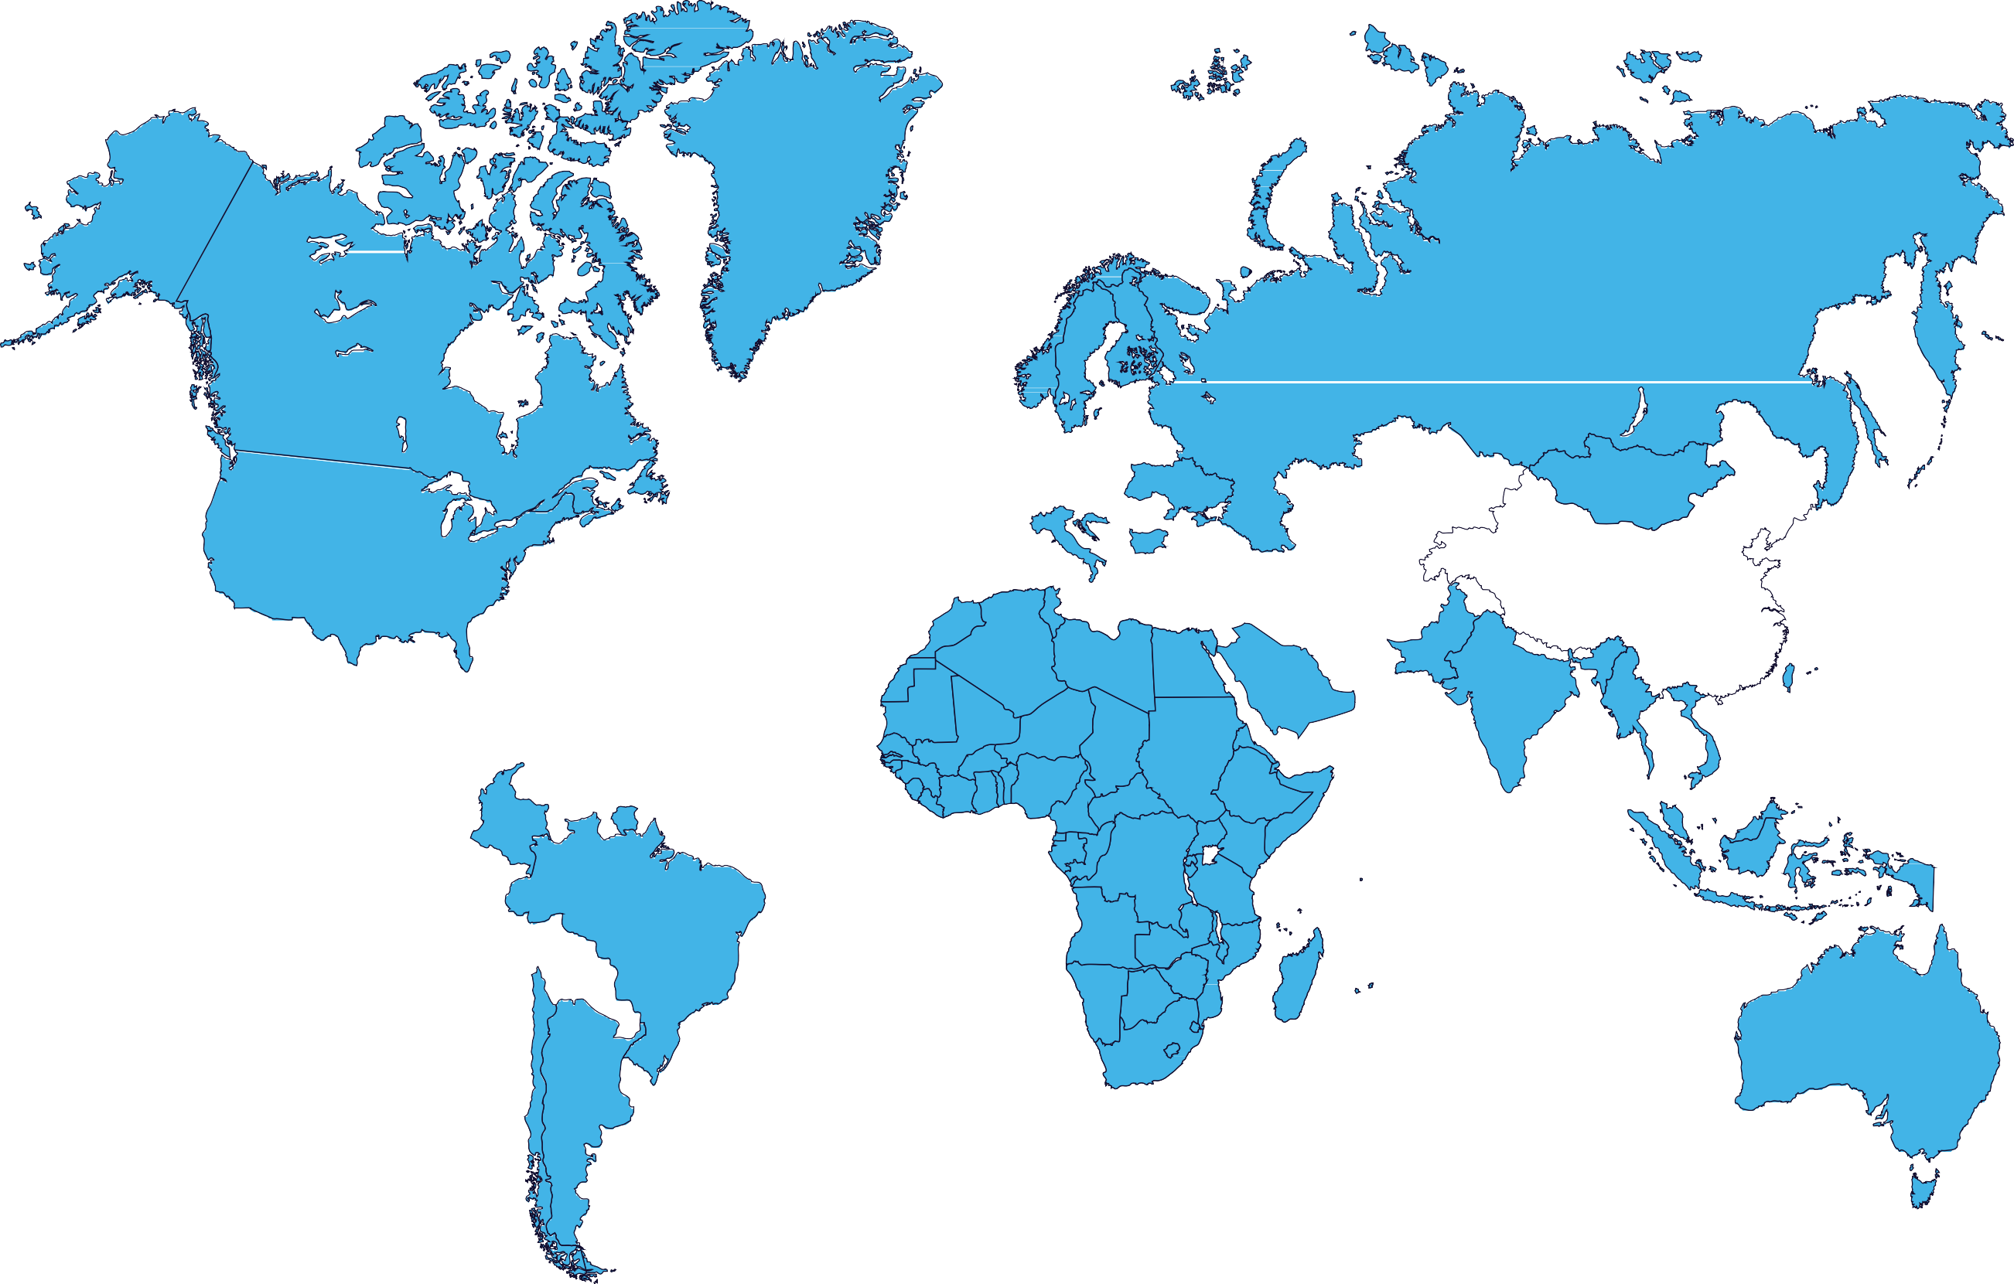
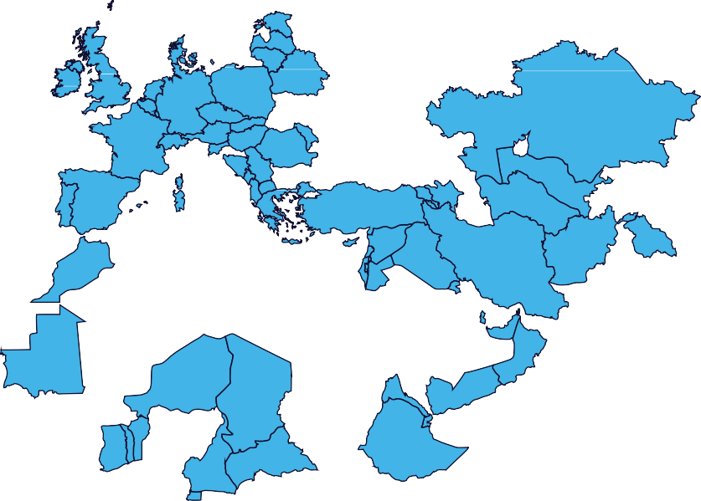
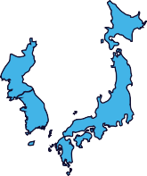
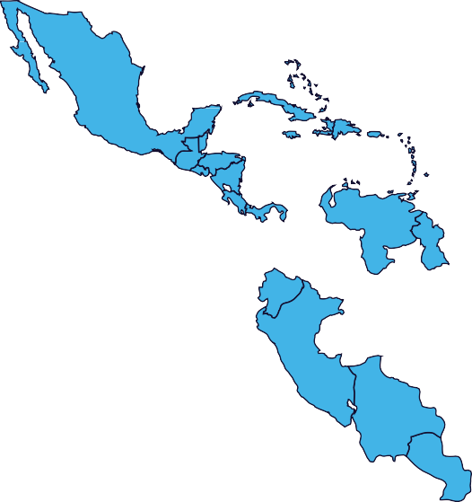
FIA WEC 2024
Broadcast Partners
Pan-Europe;
Pan-Asia-Pacifict
France, MENA,
Africa, Pan-Asia-
Pacific, Americas

Slide 3
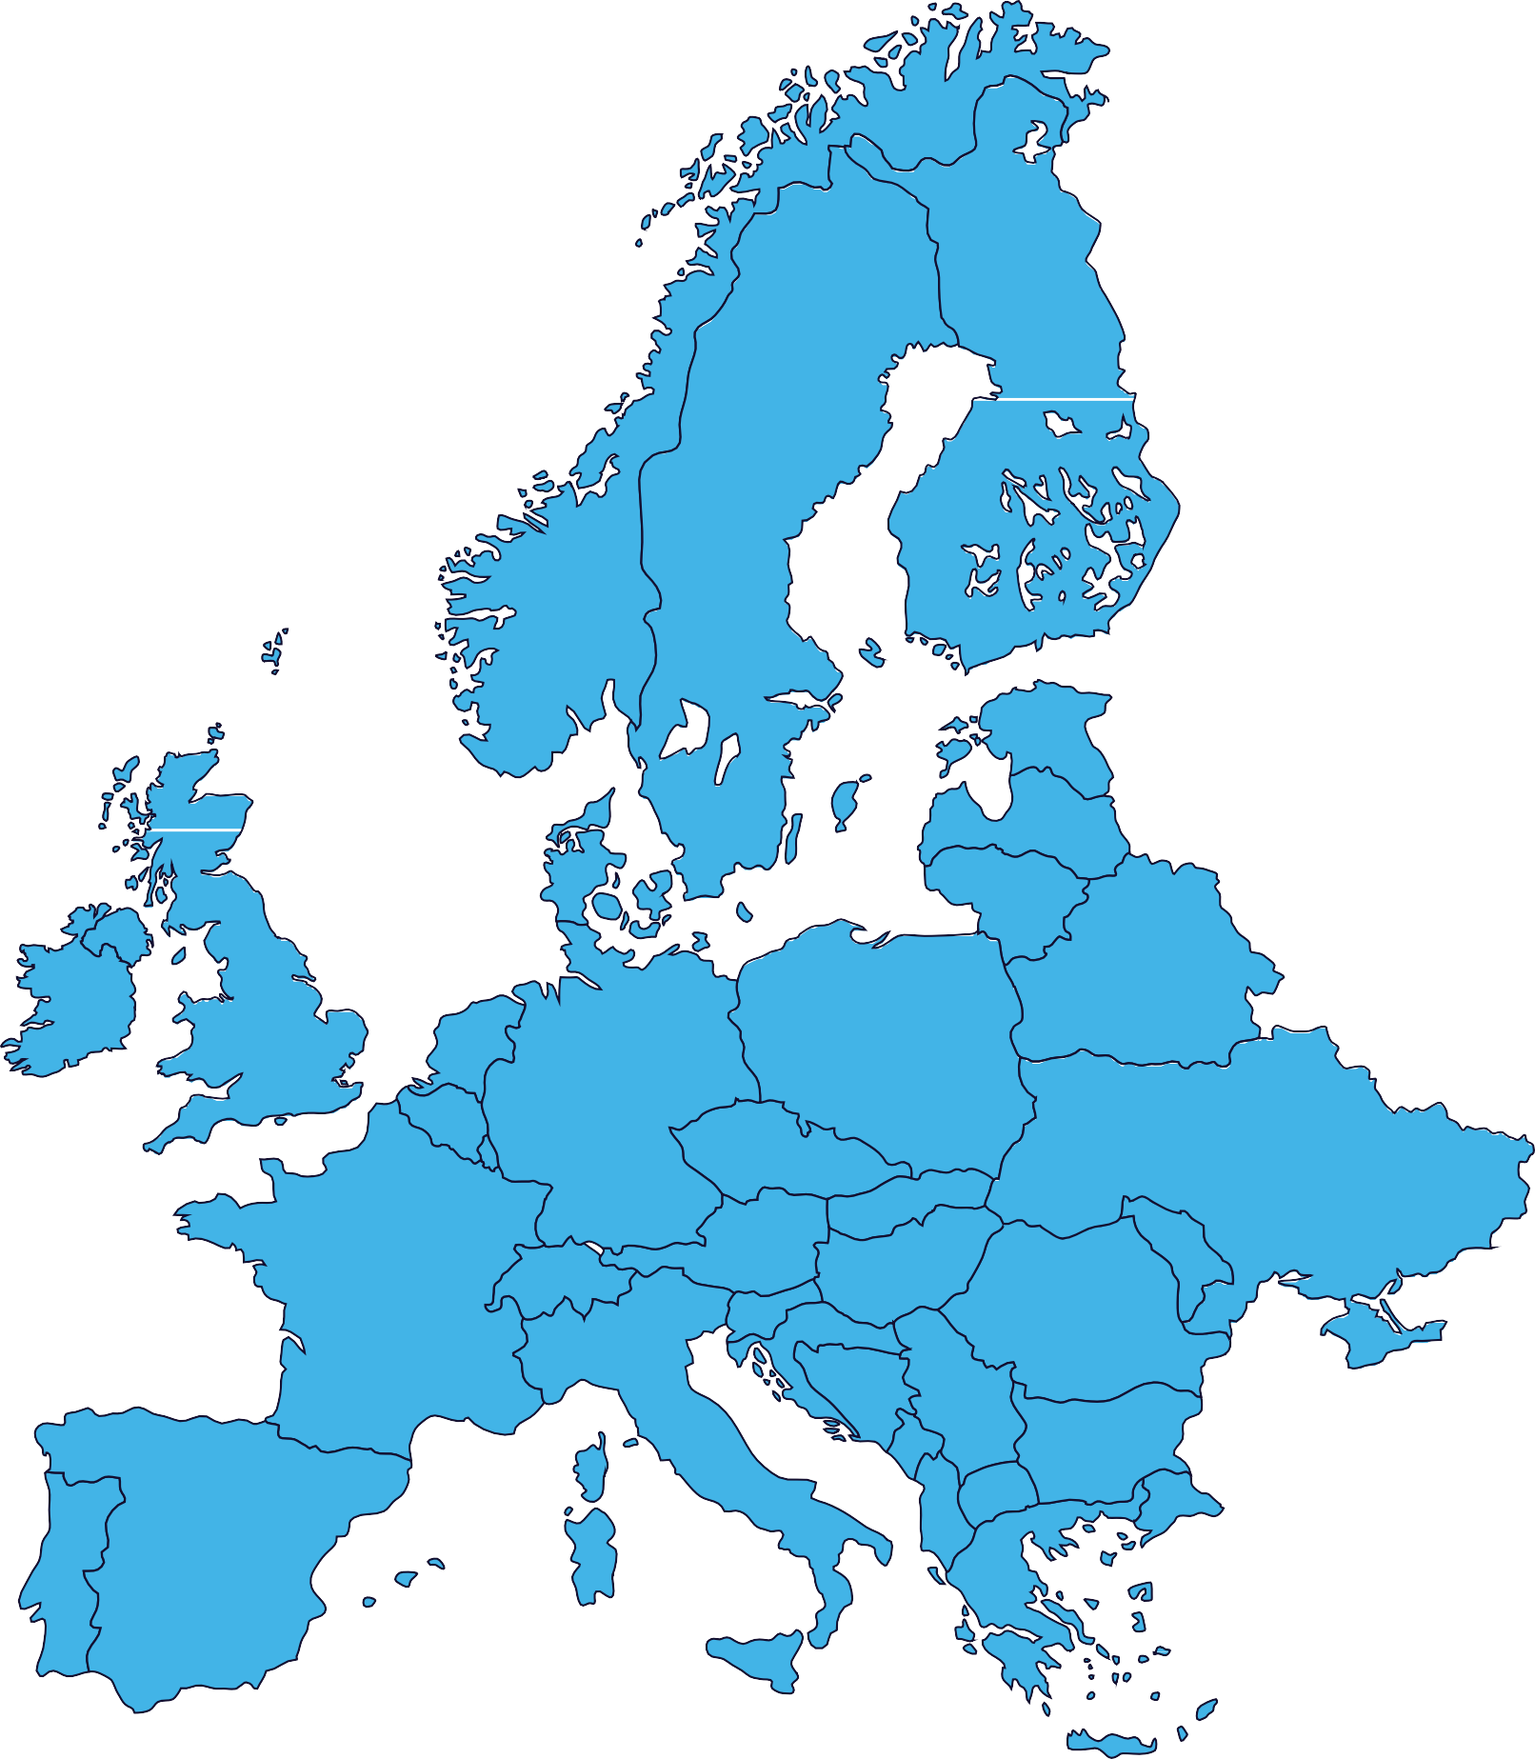
FIA WEC 2024
Broadcast Partners
Pan-Europe;
Pan-Asia-Pacifict
Eurovision sports News Pan-Europe
France, MENA,
Africa, Pan-Asia-
Pacific, Americas

Slide 4
European Broadcasters - LIVE | Rerun | Delayed
Territories | Broadcaster | Info | Local time unless stated
Pan-Europe (excluding Germany, UK) |  | Pay TV | Live Rerun | Partial Race on 01/09 19:30-22:00 on Eurosport 1 Rerun on 04/09 08:30-09:30 on Eurosport 1
Pan-Europe (AHO, ALB, ARM, AZE, CYP, EST, GEO, GRE, ISL, ISR, LAT, LIE, LTU, LUX, MDA, MLT, SUI, TUR, UKR) |  | Pay Digital | Live Live Live Rerun | FP3 on 31/08 on Player Qualification on 31/08 on Player Full Race on 01/09 19:30-02:30 on Player Rerun on 04/09 08:30-09:30 on Player All TX available as VOD
Pan-Europe (AND BIH, BUL, CRO, CZE, DEN, ESP, FIN,FRA, FRO, HUN, KOS, MKD, MNE, MON, NOR, POL, POR, ROU, SLO, SRB, SVK, SWE) |  | Pay Digital | Live Live Live Rerun | FP3 on 31/08 on Max Qualification on 31/08 on Max Full Race on 01/09 19:30-02:30 on Max Rerun on 04/09 08:30-09:30 on Max All TX available as VOD
Netherlands and Belgium |  | Pay Digital | Live Live Live Rerun | FP3 on 31/08 on Max Qualification on 31/08 on Max Full Race on 01/09 19:30-02:30 on Max Rerun on 04/09 08:30-09:30 on Max All TX available as VOD
Pan-Europe Austria, United Kingdom, Germany, Gibraltar, Ireland, Italy, San Marino, Vatican and Indian Subcontinent |  | Pay Digital | Live Live Live Rerun | FP3 on 31/08 on Discovery+ Qualification on 31/08 on Discovery+ Full Race on 01/09 19:30-02:30 on Discovery+ Rerun on 04/09 08:30-09:30 on Discovery+ All TX available as VOD

Slide 5
European Broadcasters - LIVE | Rerun | Delayed
Territories | Broadcaster | Info | Local time unless stated
Austria |  | Free-to-Air | Live | Partial Race on 01/09 22:15-02:05 on ORF Sport+
Austria |  | Free Digital | Live | Full Race on 01/09 19:55-02:05 on ORF TVThek
Balkans (Bosnia and Herzegovina, Croatia, Kosovo, North Macedonia, Montenegro, Serbia and Slovenia) |  | Pay TV | Live Live Live Live | Final 2 Race hours on 01/09 00:00-02:00 on AS1 (Croatia) Final 2 Race hours on 01/09 00:00-02:00 on AS1 (Serbia) Final 2 Race hours on 01/09 00:00-02:00 on AS1 (Slovenia) Final 2 Race hours on 01/09 00:00-02:00 on AP1 (BIH)
Belgium |  | Free Digital | Live Live | Qualification on 31/08 19:30-20:40 on AUVIO Full Race on 01/09 19:55-02:55 on AUVIO
Czech Republic |  | Pay TV | Live Live | Qualification on 31/08 on Sporty TV Full Race on 01/09 19:30-02:30 on Sporty TV
Denmark |  | Pay TV | Live

Slide 6
European Broadcasters - LIVE | Rerun | Delayed
Territories | Broadcaster | Info | Local time unless stated
Denmark |  | Pay Digital | Live Live Live | FP3 on 31/08 on TV 2 PLAY Qualification on 31/08 on TV 2 PLAY Full Race on 01/09 20:00-02:00 on TV 2 PLAY
Finland |  | Pay TV | Live Live | Qualification on 31/08 22:50-00:20 on MTV MAX Full Race on 01/09 20:30-03:30 on MTV MAX
Finland |  | Pay Digital | Live | Full Race on 01/09 20:30-03:30 on MTV Katsomo
France |  | Free-to-Air | Live Live | Race part 1 on 01/09 19:30-22:38 on L’Équipe Race part 2 on 01/09 00:40-02:20 on L’Équipe
France |  | Free Digital | Live | Full race
Germany/DACH |  | Free-to-Air | Live | Partial Race on 01/09 23:00-02:15 on Sport1

Slide 7
European Broadcasters - LIVE | Rerun | Delayed
Territories | Broadcaster | Info | Local time unless stated
Germany / DACH |  | Free TV | Live Rerun | Partial Race on 01/09 19:30-22:00 on Eurosport 1 Rerun on 04/09 08:30-09:30 on Eurosport 1
Italy |  | Pay TV | Live | Full Race on 01/09 10:00-02:00 on Sky Sport Arena
Netherlands |  | Pay Digital | Live | Full Race on 01/09 19:50-02:30 on Videoland
Poland |  | Pay TV | Live
Romania |  | Pay Digital | Live Live Live | Free Practice 3 on 31/08 on AntenaPLAY Qualification on 31/08 on AntenaPLAY Full Race on 01/09 20:45-03:00 on AntenaPLAY

Slide 8
European Broadcasters - LIVE | Rerun | Delayed
Territories | Broadcaster | Info | Local time unless stated
Slovakia |  | Free TV | Live Live Rerun
UK |  | Pay TV | Live Rerun | Partial Race on 01/09 17:30-20:00 on Eurosport 1 Rerun on 04/09 06:30-07:30 on Eurosport 1

Slide 9
Americas Broadcasters - LIVE | Rerun | Delayed
Territories | Broadcaster | Info | Local time unless stated
Brazil |  | Free-to-Air | Live
Brazil |  | Pay TV | Live | Partial Race on 01/09 15:00 - 19:00 on Band Sports
Brazil |  | Free Digital | Live
Brazil |  | Free Digital | Live
Brazil |  | Free Digital | Live Live Live Live
Canada |  | Pay TV | Live | Full Race on 01/09 from 13:30-20:30 on Velocity

Slide 10
Americas Broadcasters - LIVE | Rerun | Delayed
Territories | Broadcaster | Info | Local time unless stated
Mexico |  | Pay TV | Live | Full Race on 01/09 11:30-18:30 on FOX Sports 3
USA |  | Pay TV | Live Live | Race part 1 on 01/09 13:30-15:00 on Motortrend Race part 2 on 01/09 19:00-20:30 on Motortrend
USA |  | Pay Digital | Live Live Live | FP3 on 31/08 on Max Qualification on 31/08 on Max Full Race on 01/09 12:30-19:30 on Max Rerun on 04/09 01:30-02:30 on Max All TX available as VOD
Central & South America Caribbean (excl. Mexico & Brazil) ARG time |  | Pay TV | Live Live | Qualifying on 31/08 17:00-18:10 on Dsports Motor Full Race on 01/09 14:30-21:30 on Dsports Motor
Central & South America Caribbean (excl. Mexico & Brazil) CHI time |  | Pay TV | Live Live | Qualifying on 31/08 16:00-17:10 on Dsports Motor Full Race on 01/09 13:30-20:30 on Dsports Motor
Central & South America Caribbean (excl. Mexico & Brazil) COL time |  | Pay TV | Live Live | Qualifying on 31/08 15:00-16:10 on Dsports Motor Full Race on 01/09 12:30-19:30 on Dsports Motor

Slide 11
Asia-Pacific Broadcasters - LIVE | Rerun | Delayed
Territories | Broadcaster | Info | Local time unless stated
Australia |  | Pay Digital | Live Live Live Rerun | Full FP3 on 01/09 02:00 on Stan Sport Full Qualification 01/09 06:00-07:40 on Stan Sport Full Race on 02/09 from 04:00-10:00 on Stan Sport Reruns as VOD
China |  | Pay Digital | Live Live | Full Race on 02/09 from 01:30-08:30 on HeXin RacingChatterbox Full Race on 02/09 from 01:30-08:30 on 24hourSports
India |  | Pay TV | Live
Indonesia |  | Free Digital
Japan |  | Pay TV | Live Rerun Rerun | Full Race on 02/09 02:30-09:30 on J Sports 3 Full reruns on 04/09 06:00-13:00 on J Sports 1 Full reruns on 06/09 15:00-22:00 & 12/09 15:00-22:00 on J Sports 3
Japan |  | Pay Digital | Live Live | Qualification on 01/09 04:50-08:00 and as VOD Full Race on 02/09 02:30-09:30 and as VOD
Douyin
Kuy Entertainment

Slide 12
Asia-Pacific Broadcasters - LIVE | Rerun | Delayed
Territories | Broadcaster | Info | Local time unless stated
Pan-APAC |  | Pay TV | Live Rerun | Partial Race on 01/09 17:30-20:00 on Eurosport Asia (GMT) Rerun on 04/09 06:30-07:30 on Eurosport Asia (GMT)

Slide 13
Pan-African, MENA and Other Broadcasters - LIVE | Rerun | Delayed
Territories | Broadcaster | Info | Local time unless stated
Sub-Saharan Africa |  | Pay TV | Live Rerun | Full Race on 01/09 20:00-02:00 on MSP / MSPA Full reruns on 02/09 11:00-17:00, 04/09 18:30-00:30 and 05/09 06:00-12:00 on MSP/MSPA
MENA |  | Pay Digital | Live | Full race on WEC App

Slide 14
European Broadcasters – HL | News
Territories | Broadcaster | Info | Local time unless stated
Austria |  | Free-to-Air | HL
Czech Republic |  | Pay TV | HL | HL on 04/09 tbc on Sporty TV, 3 additional HL tba
Czech Republic & Slovakia |  | Pay TV | HL | HL on 04/09 20:10, 05/09 12:05, 06/09 09:00, 08/09 17:00 and 11/09 23:05 on Nova Sport 5 HL on 05/09 19:00, 06/09 12:15, 07/09 16:00, 08/09 19:00 and 09/09 14:00, 13/09 17:00 and 14/09 23:30 on Nova Sport 6
Finland |  | Pay TV Pay Digital | HL HL | HL on 05/09 12:00-12:52 on MTV Max, 5-8 additional HL tba HL on MTV Katsomo as VOD
Germany/DACH |  | Free-to-Air Pay TV | HL | HL on 05/09 03:00-01:00 on Sport1 HL on Sport1+ tba
Germany/DACH |  | Pay TV | HL

Slide 15
European Broadcasters – HL | News
Territories | Broadcaster | Info | Local time unless stated
Germany |  | Pay Digital | HL | HL on RTL+ as VOD
Netherlands & Luxembourg |  | Free-to-Air | HL | HL on 09/09 15:00-16:00 and 14/09 15:00-16:00 on RTL 7
Italy |  | Free Digital | HL | HL on Mediaset Infinity as VOD
Italy |  | Free Digital | HL | HL as VOD News
Italy |  | Pay TV | HL
Poland |  | Pay TV | HL | HL on 05/09 20:10-21:55 on Motowizja, 7 additional HL tba

Slide 16
European Broadcasters – HL | News
Territories | Broadcaster | Info | Local time unless stated
Poland |  | Pay TV | HL
Romania |  | Pay Digital | HL | HL on AntenaPLAY as VOD
Slovakia |  | Free TV | HL
Switzerland |  | Free-to-Air | News | News Access
Pan-Europe |  | Free-to-Air | News | News Access

Slide 17
Americas Broadcasters – HL | News
Territories | Broadcaster | Info | Local time unless stated
Argentinia |  | Pay TV | HL | HL on Fox Sports (date tba)
Brazil |  | Free-to-Air | HL
Mexico |  | Pay TV | HL | HL on 07/09 12:00-13:00 on Fox Sports 3, 6 additional HL tba
USA |  | Pay Digital | HL | HL available online as VOD
Central & South America Caribbean (excl. Mexico & Brazil) |  | Pay TV | HL | HL on 07/09 22:00-23:00 on DSports Motor

Slide 18
Asia-Pacific Broadcasters – HL | News
Territories | Broadcaster | Info | Local time unless stated
Australia |  | Pay Digital | HL | HL on 04/09 10:00-11:00 on Stan Sport and VOD
Australia |  | Free-to-Air | HL | HL on 07/09 13:30-14:30 on 9GO!, 1 additional HL tba
India |  | Pay TV | HL
Japan |  | Pay TV | HL | HL on 13/09 22:00-23:00 on J Sports 3, 10 additional HL tba
New Zealand |  | Free-to-Air Free Digital | HL | HL on 08/09 on TV3 HL available as VOD on Three Now
Taiwan |  | Pay TV | HL | HL on 15/09 21:00-21:10 on Elta Sports1

Slide 19
Asia-Pacific Broadcasters – HL | News
Territories | Broadcaster | Info | Local time unless stated
Pan-APAC |  | Pay TV | HL
Pan-Asian Territories |  | Pay Digital | HL

Slide 20
Pan-African, MENA and Other Broadcasters – HL | News
Territories | Broadcaster | Info | Local time unless stated
Sub-Saharan Africa |  | Pay TV | HL | HL on 06/09 19:00, 07/09 01:00, 07/09 06:00, 09/09 13:00, 10/09 20:00, 11/09 08:00 and 12/09 17:00on MSP/MSPA
Europe (France, Belgium, Switzerland, Monaco), MENA, Pan-Africa, Pan-Asia-Pacific, Central- & South America, USA |  | Free-to-Air | HL | HL on TV5 Monde (date tba)

Slide 21
Radio Broadcasters & Other Media
Territories | Broadcaster | Info | Local time unless stated
Worldwide |  | Free | Live | Full Race Live Commentary
Worldwide |  | Pay Digital | Live HL | Full Race live on 01/09 HLs available online

Slide 22
Radio Broadcasters & Other Media
Broadcaster | Territories | Local time unless stated
 | Worldwide | Live | Full Race Live Commentary
 | Worldwide | Clips | Coverage in Mobil 1: The Grid distributed internationally

